Slide 1


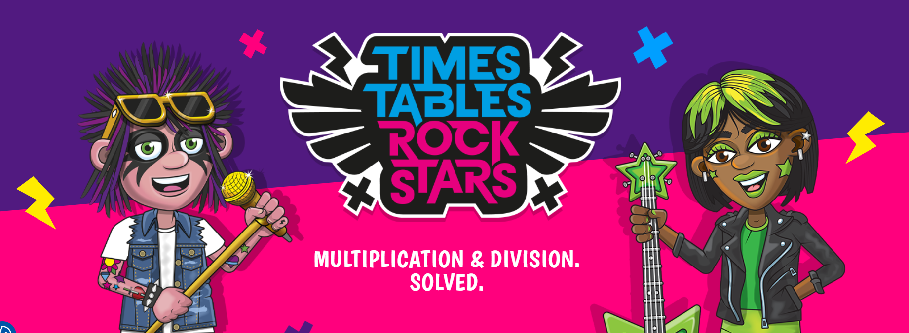
Parent Times Tables Workshop
Tuesday 12th November
Notes:
Thank parents for attending.
Outline that the summary of the meeting:
Explain the expectation of children in school regarding their times tables.
Show what we do in school to support the teaching of times tables
Explore TTR and how this can be used at home
Information about MTC
Set expectations for supporting times tables at home.

Slide 2
Question 9
Question 1
Question 2
Question 3
Question 4
Question 5
Question 6
Question 7
Question 10
Question 8
7 | × | 6 | =
6 | × | 9 | =
7 | × | 7 | =
8 | × | 6 | =
12 | × | 6 | =
7 | × | 8 | =
6 | × | 7 | =
9 | × | 12 | =
8 | × | 9 | =
8 | × | 8 | =
Notes:
Here is a mini test which their children have to complete in school. (This is taken from the NCETM)
54, 49, 48, 72, 56, 42, 108, 64, 42, 72

Slide 3
In school-
Children are required to know their times tables up to 12x 12 by year 4.
Times tables are a fundamental element in accessing all areas of mathematics.
Children should be able to accurately and fluently recall their times tables with only 6 seconds per question.
Notes:
Although the children should be fluent by year 4, we are implementing the teaching of ALL times tables lower down the school to support children as they move through their education.
Children who do not know their times tables find this a barrier to access other areas of maths and this can prevent progression through their learning journey.
Like the test you just saw, children are expected to know their times tables fluently and accurately with only 6 seconds between questions. In order for children to do this, they must be secure in their knowledge of each times tables. Children have a much better chance in succeeding at this is.

Slide 4
What do we do in school?
Teach Mastery number in Year 4
Times tables RockStars.
Rolling numbers.
Notes:
Mastery number helps underpin the understanding of times tables. E.g. times tables is communitive, gives unitised counters, pictorial representations and multiplication representations.
TTR- the soundcheck on rockstars is identical to the MTC that Y4 children complete in the spring term. It is a great platform for preparing the children for the test. In Y4 we complete 3x 10 minute sessions per week and this is something we are going to be implementing in Y3 too. We are able to set sessions, provide practice for individual times tables and allow children to take ownership of their own learning by helping them to engage with their heatmaps.
Rolling numbers is a chant that children learn and a scaffold children can use to support their learning. Children should ALWAYS track on their fingers a this trains the brain to associate each finger with a different times table.

Slide 5

TTR-
A live demo (A user guide has been added to the website for you to refer back to if needed)
Please contact your child’s class teacher for a login if you do not have one.
Notes:
Complete a live demo with Child A’s login. A user guide has been created which will be added to the website that parents can refer back to.
A user guide uploaded to the website for parents who were unable to attend.

Slide 6
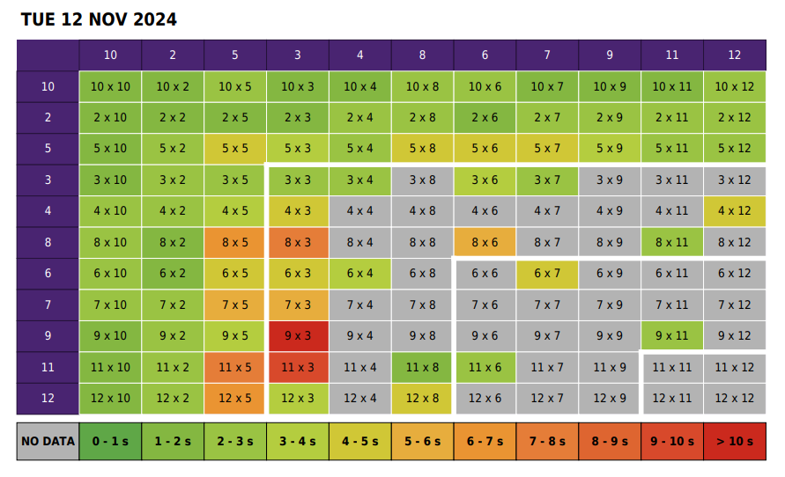
Notes:
An example of a heatmap

Slide 7
MTC!
What is the Multiplication Tables Check?
The checks consist of 25 times tables questions. The questions will only be multiplication and they will go up to 12×12. There’s nothing novel about the questions and they don’t require problem solving so there’s nothing to trip them up.
There will be 6 seconds to answer each question.
The check will be taken online during school time.
There is no pass mark.
Teachers will be able to apply for some children to be able to pause between questions.
Notes:
The Multiplication Tables Check for year 4 children is happening between Monday 2nd June and Friday 13th June 2025. A letter has been handed out to year 4 parents during parents evening. Additional letters are printed if parents would like to take them today- also displayed on the website

Slide 8
Supporting your child at home.
There are lots of ways to learn times tables, but here are a few suggestions to get you started:
Make sure they play a minimum of 3x per week in Garage mode on Times Tables Rocks Stars - The Garage game mode is very clever and will adjust the questions your child is asked, ensuring they are always working on the facts they need to improve. Also, give them a times tables square to use whilst they play. This way they can double-check facts they are not sure about
Sing times tables songs (rolling numbers is used in school). There are hundreds available! Put them on in the car, bathtime or any ‘free’ time where you have a few spare minutes.
Chanting the old-fashioned way- rehearse the tables forwards and backwards, gradually increasing in speed.
Plenty of praise- When encouraging children to pursue something important, like timetables, there’s no harm in heightening their enthusiasm with plenty of praise. ‘You got this!’ ‘Look at your heatmap now!’
Write out the tables – This can be in the form of a simple list or you could also be a bit more fun. Being creative will make writing and learning the tables more enjoyable.
  Write the facts as the petals of a flower;
  Get them to test you on the facts and get them wrong on purpose and see if they correct you!
  Treasure Hunt: Hide the facts around the house and give them the answers. Can they find them in record time?
  Take a pot of water and a paintbrush outside to ‘paint’ the facts on a wall.
  Use chalks to write the facts outside in giant numbers.
Times tables are important, but it should be an enjoyable experience learning them!

Slide 9

Thank-you for attending!
Any questions?

