Slide 1

Year 1
Phonics & Reading
“If you are going to get anywhere in life you have to read a lot of books.” – Roald Dahl

Slide 2

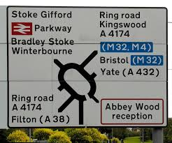
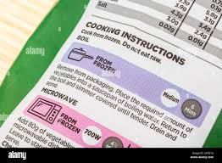
How many times have you read today?
Notes:
We read in all walks of life, on a daily basis. Reading is cruial for a child's success in life.
Reading, promoted by the National Literacy Trust, is vital for life, enhancing individual success, well-being, and social mobility by providing essential literacy skills, boosting confidence and empathy, and combating the cycles of poverty associated with low literacy. Through reading for pleasure, individuals can improve their academic attainment, mental health, and employment opportunities, ultimately enabling them to achieve a better quality of life and better understand the world around them.

Slide 3

Phonics
To become fluent readers and spellers children need to know:
  1: Letters are used to spell individual sounds (one at a time, from left to right across the page).
  2: Each sound may be spelled by one or more letters.
  cat ship night weight

Slide 4
What skills need to be practised and perfected to become a fluent reader?
  Segmenting
  Blending
  Phoneme manipulation
  You also need code knowledge: how to spell the sounds in the language

Slide 5
Teaching order

Slide 6
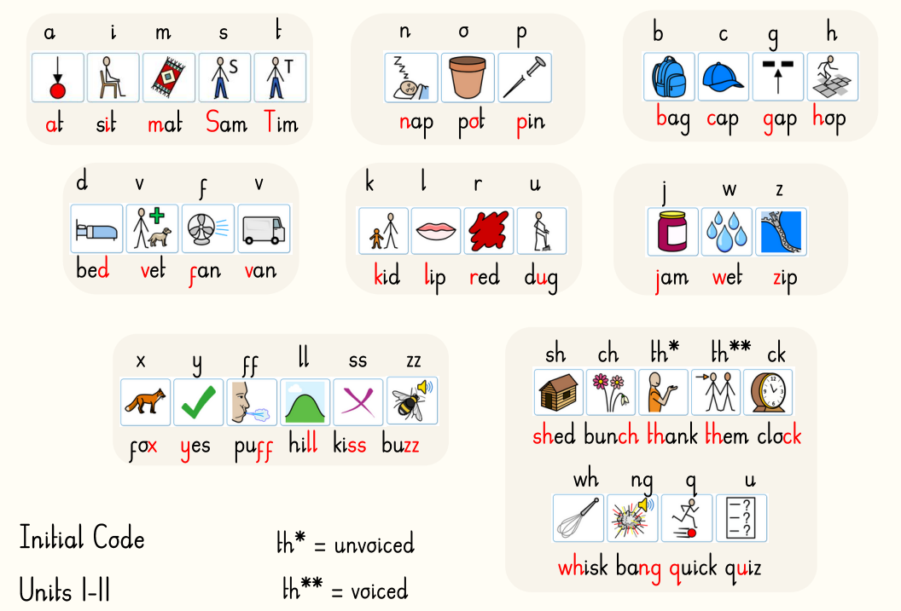
Notes:
During EYFS, your child will have focused on learning sounds from the initial code. Here are those sounds.

Slide 7
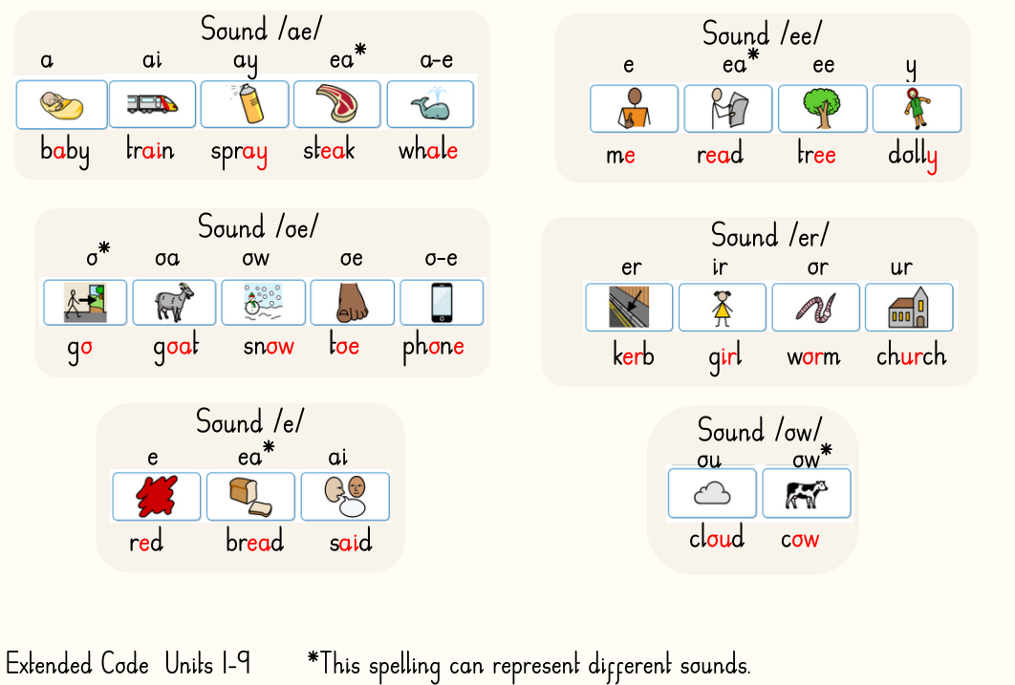
Notes:
During y1, we continue to review the sounds learnt in EYFS and move learning on by teaching the sounds in the extended code.
They are grouped into sound families - share some

Slide 8
Phonics Lessons
We teach phonics for 30 minutes every day
The lesson is split into 3 parts
Review
Current Unit
Reading & Writing in a Connected text
​ Fish - word building - YouTube
Notes:
Review – where we review sounds previously taught – games, building, reading and spelling words.
Current unit – teaching new sound spellings
Reading & writing in connected text – this involves writing a dictated sentence or reading a class book which contains sounds we have leared so far. This involves focusing on any new vocabulary and becoming a fluent reader. One method we use for this is echo reading where the children echo back the sentnce read to them, using intonation and expression modelled by the teacher.
The lessons are scripted to ensure consistency in teaching across classes and across year groups. The scheme will follow this cohort of children up through the school and continues right up to year six.

Slide 9
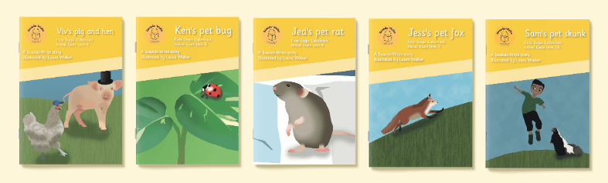
Reading Books
Notes:
You will already be familiar with the sounds write reading books.
The children will receive 1 reading book a week and be read with once a week at school.
At three trees we ask that you read with your child at least 3 times a week and sign their diary each time. 5-10 mins a time, not the whole book.
This will really increase their reading skills. Certificates.
If the book has not been signed, it will most likely not get changed.

Slide 10
2:46 – 4:49 Reading a decodable story with Max
Reading at home

Slide 11
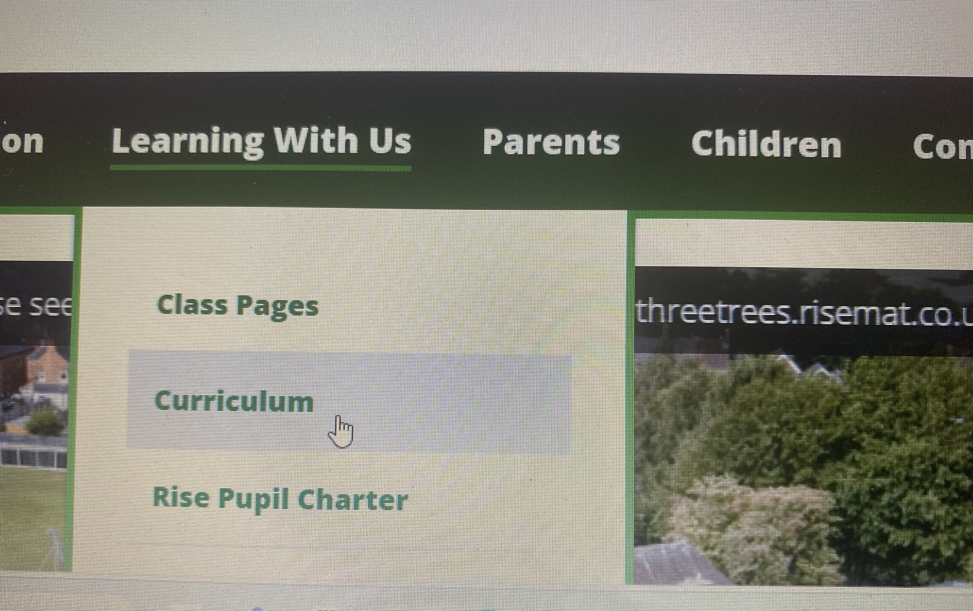
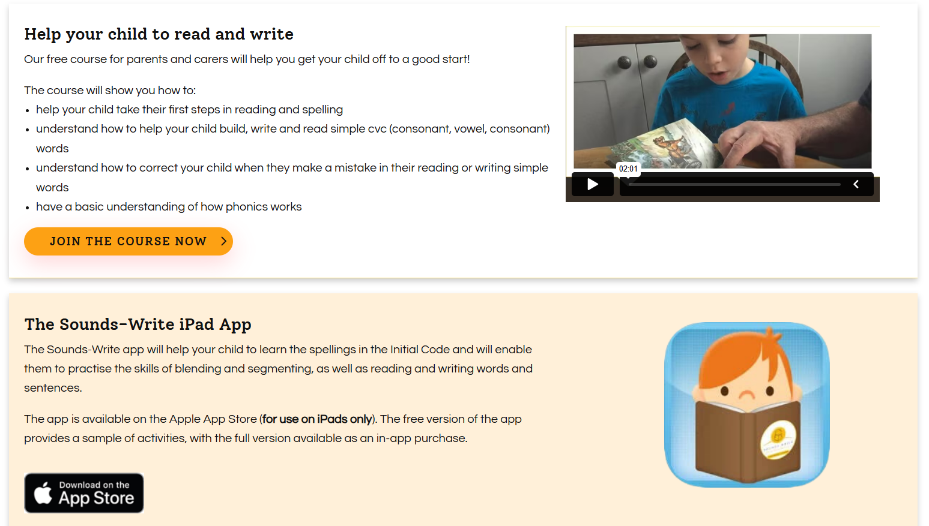
Sounds Write Parent Resources
Notes:
Link on school website

Slide 12

Thank you for coming!

